Slide 1


DataBase Logic in Business Applications
Al.I. Cuza University of Iași
Faculty of Economics and Business Administration
Department of Accounting, Information Systems
and Statistics
Introduction to Data Modeling. Entity-Relationship vs. UML Class Diagrams
By Marin Fotache & Co.

Slide 2
Notice
All the Oracle Data Modeler diagrams in this presentation are archived and can be downloaded at:
https://github.com/marinfotache/Database-Logic-in-Business-Applications/tree/master/04_DB%20Logical%20Design__Denormalization
Please follow the instructions in `readme.md` file

Slide 3
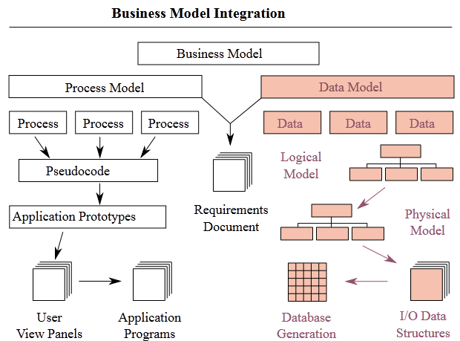
Types of DataModels in Software Development
Source: http://en.wikipedia.org/wiki/Data_model#Patterns

Slide 4
Data Models
A model is a vehicle for describing reality
Data models describe the structure of persistent (stored) information within an organization area
Models assume abstracting, simplification/reduction, and generality
Do not confound the model with the reality!
Basic modeling tools:
Classification
Aggregation
Generalization
A typical confusion in data modeling between:
Modeling method (normalization, E-R, Rational Unified Process, ...) and
Modeling language (usually UML)

Slide 5
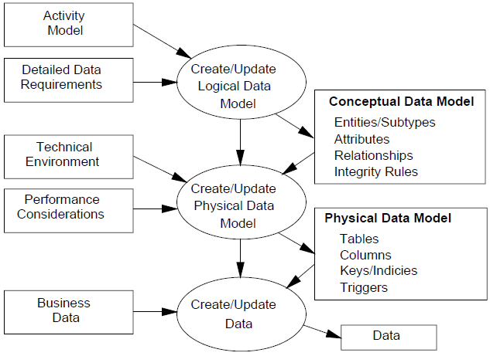
A Few Data Modeling Areas
Source: http://www.matthew-west.org.uk/documents/princ03.pdf

Slide 6
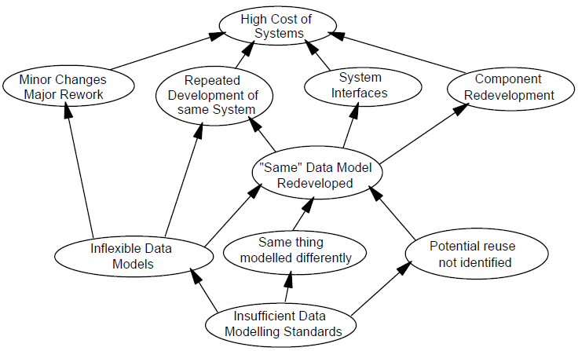
Typical Data Modeling Issues
Source: http://www.matthew-west.org.uk/documents/princ03.pdf

Slide 7
Data Model Representation
Lax
Text (Word, Notepad, Notepad++, ...)
PowerPoint drawings (diagrams)
Rigurous (by diagrams):
Entity-Relationship, using notations such as:
Chen (original)
EER (Enhanced Entity-Relationship)
Barker (Oracle Case)
IDEF1X
IE (Information Engineering) ....
UML
Stardardized (UML 1.0, 1.1…)
Implemented in current modeling applications (Visual Paradigm, ArgoUML, Software Ideas Modeler, ...)

Slide 8
Modeling Approach in This Course
Entity-Relationship. For recap of E-R models, methodology, diagrams, see:
Entity-Relationship Diagrams: https://www.youtube.com/watch?v=c0_9Y8QAstg&spfreload=10
ER Diagram in DBMS - SKU Database Management System: https://www.youtube.com/watch?v=xAr5BLFMcgo&spfreload=10
Database Lesson #4 of 8 - Data Modeling and the ER Model: https://www.youtube.com/watch?v=IfaqkiHpIjo&spfreload=10
Conceptual Data Modeling with Entity Relationship Diagrams
https://www.youtube.com/watch?v=wo-Wyul8CDQ
Barker (Oracle Case / Oracle Data Modeler) Notation: Database schema will be designed in ODM and the DDL script or sub-schema will be automatically generated

Slide 9
Basic Concepts of E-R (1)
Source: Teorey, T. s.a. – Database Design. Know It All, MK, Amsterdam, 2009
Concept | Description | Examples
Entity | Collection of real or abstract objects sharing a series of properties. Different from relational terminology that uses the plural (Students, Books) | Student, book, customer, employee, invoice, product
Attribute | Data item that describes a property of an entity or of a relationship | Student_Code, ISBN, Invoice_Date, Price
Identifier | A single attribute or a set of attributes that takes on unique values for each entity instance | Student_Code, ISBN, Transaction_Id
Descriptor | A non-identifier attribute describing an entity or a relationship | Invoice_Date, Genre, Year_of_Study, Master_Programme
Composite Attribute | Group of single (simple) attributes describing a property of an entity or of a relationship | Student_Address
Multi-valued attribute | Entity or relatioship attribute that can take on multiple values for a single entity or relationship instance | Article_Tags, Student_Hobbies, Customer_Phones

Slide 10
Basic Concepts of E-R (2)
Source: Teorey, T. s.a. – Database Design. Know It All, MK, Amsterdam, 2009
Concept | Description | Examples
Relationship | Semantic link between (two or more) entities | Teaches, sells, borrows, works_on, manages, pays, requires, evaluates
Binary Relationship | A relationship between two entities | Teaches, sells
Recursive Relationship | A binary relationship that relates an entity to itself | Manages, Is_Managed
Ternary Relationship | A relationship among three entities. Usually avoided (see row below) | Examines_3 (A teacher examines a group of students on a course topics)
n-ary Relationship | A relationship on more than two entities. Can be replaced by a number of distinct binary relationships. Not supported by most modeling tools (such as ODM) | Examines_4 (A teacher examines in a classroom a group of students on a course topics)

Slide 11
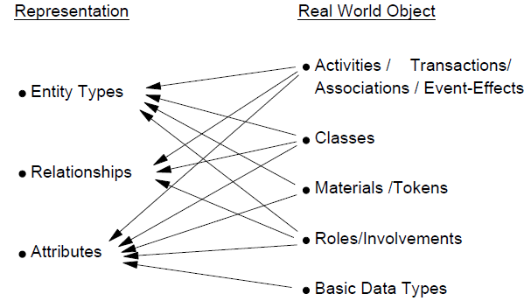
Mapping Real World Objects to E-R Concepts
Source: http://www.matthew-west.org.uk/documents/princ03.pdf

Slide 12
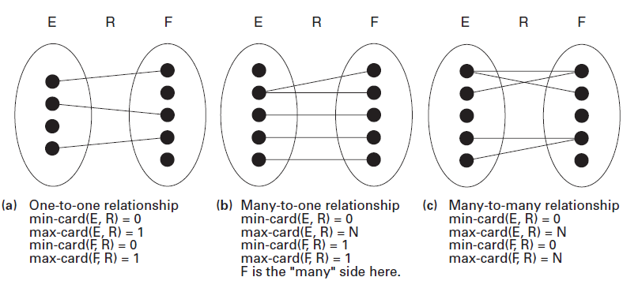
Cardinality of entities E and F within relationship R
Source: Teorey, T. s.a. – Database Design. Know It All, MK, Amsterdam, 2009

Slide 13
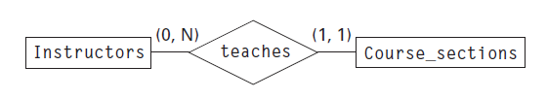
E-R Diagrams – Chen notation
A faculty member (professor) teaches zero, one, or more course sections/lectures/topics; zero means she/he is retired (consultant) or researcher (no currently teaching)
A course section is taught by only one professor; there are no course sections without associated teacher
Source: Teorey, T. s.a. – Database Design. Know It All, MK, Amsterdam, 2009

Slide 14
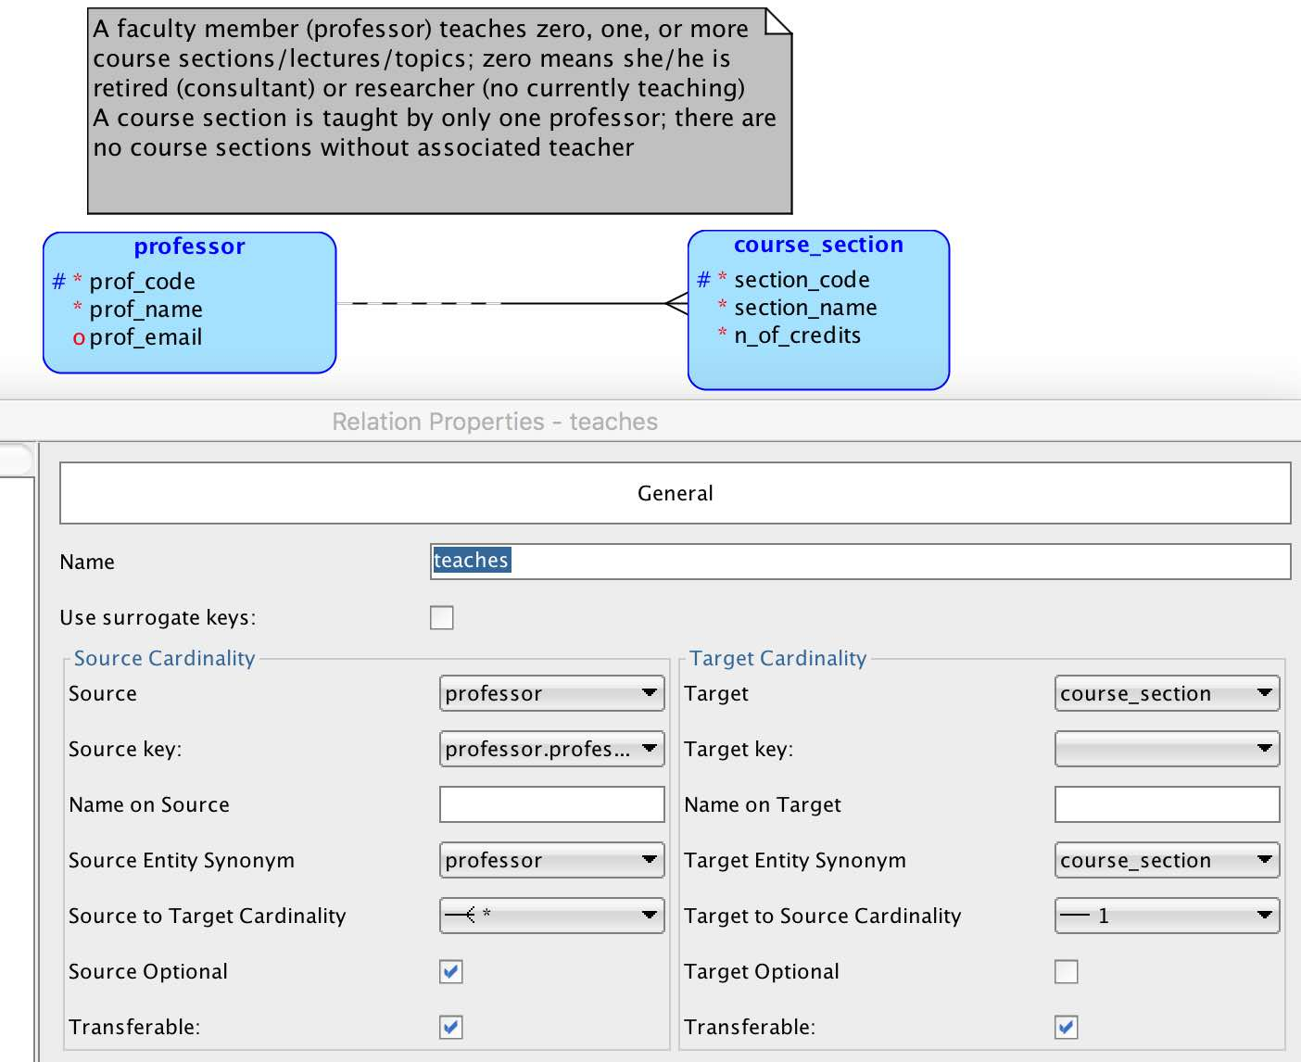
teaches_1 E-R Diagram in ODM

Slide 15
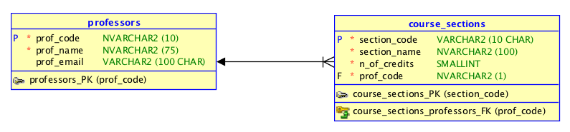
teaches_1 Relational Diagram in ODM
Attribute type and length added
Primary keys
Foreign (keys) – in E-R diagrammes foreign keys are not represented (there is no concept of foreign key)

Slide 16
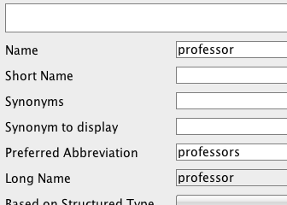
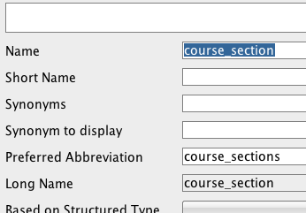
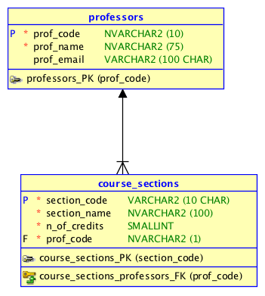
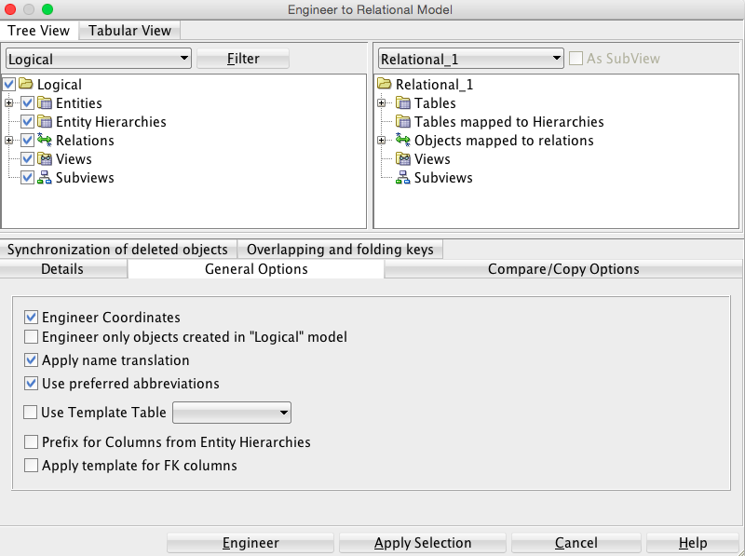
teaches_1 Relational Diagram in ODM using plurals (for table names)

Slide 17
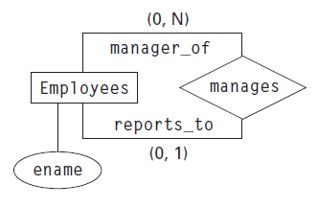
Recursive Relationship (Chen notation)
Each employee has at least zero managers (the case of general manager/CEO) and at most one manager (reports to)
A manager could have zero (☺) or more subordinates
Source: Teorey, T. s.a. – Database Design. Know It All, MK, Amsterdam, 2009

Slide 18
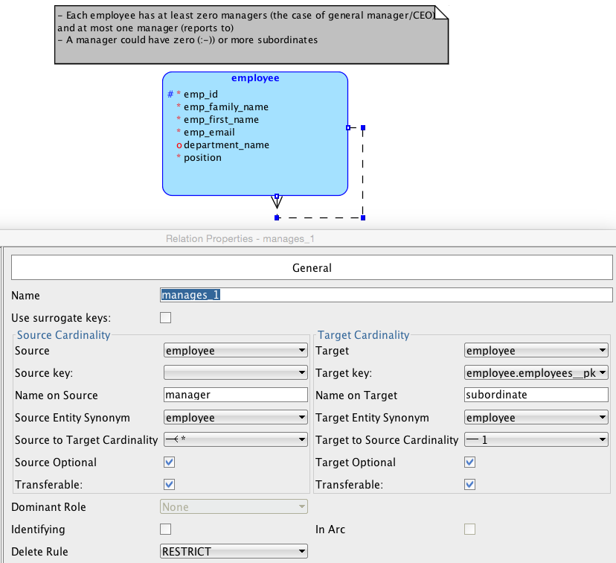
Recursive Relationship (manages_1) in ODM)

Slide 19
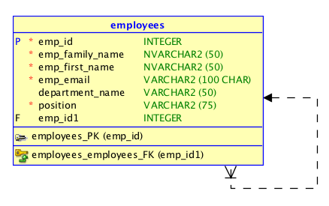
Relational Schema for Recursive Relatioship (manages_1) in ODM)

Slide 20
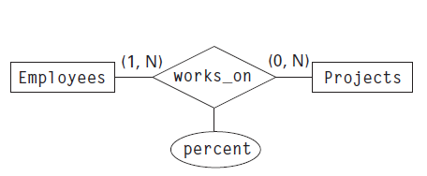
E-R concepts not recommended in ODM
Relationship attributes (implemented, but not recommended) – they will be included in one of the relationship entities
N-ary relationships, where N > 2 (not implemented)
Source: Teorey, T. s.a. – Database Design. Know It All, MK, Amsterdam, 2009

Slide 21
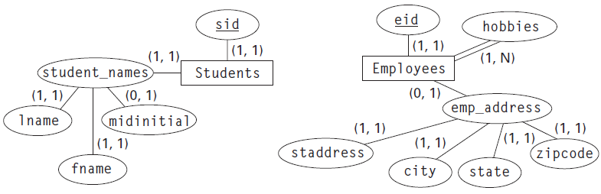
E-R concepts not implemented in ODM (cont.)
Attribute cardinality
Source: Teorey, T. s.a. – Database Design. Know It All, MK, Amsterdam, 2009

Slide 22
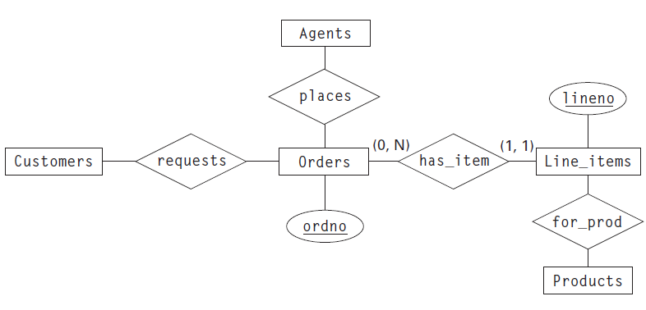
Weak Entities
A weak entity is an entity whose occurrences are dependent for their existence, through a relationship R, on the occurrence of another (strong) entity.
Source: Teorey, T. s.a. – Database Design. Know It All, MK, Amsterdam, 2009

Slide 23
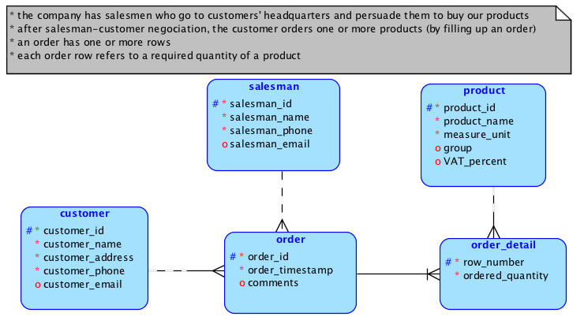
Weak Entity in orders_1 Diagram

Slide 24
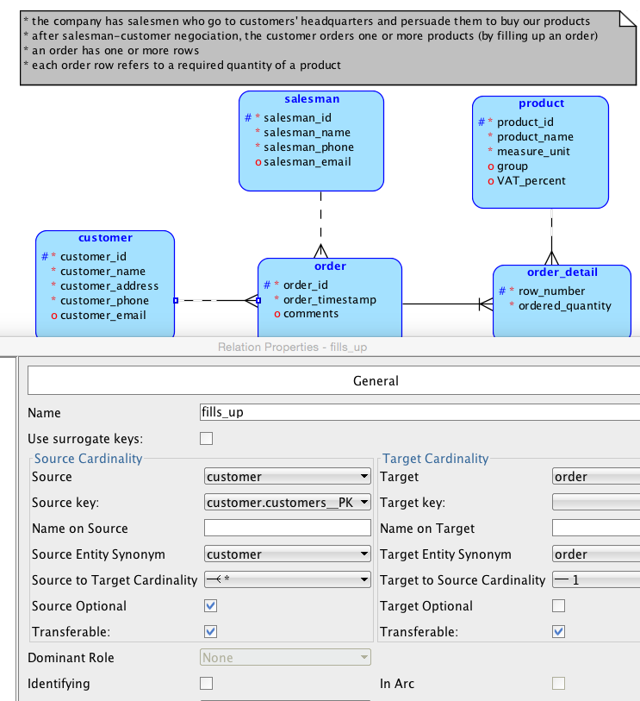
A Relationship Between Two Strong Entities in orders_1 Diagram

Slide 25
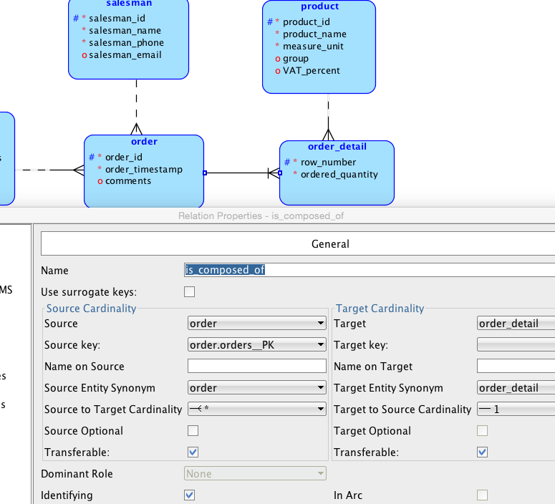
Relationship Between A Strong and A Weak Entity in orders_1 Diagram

Slide 26
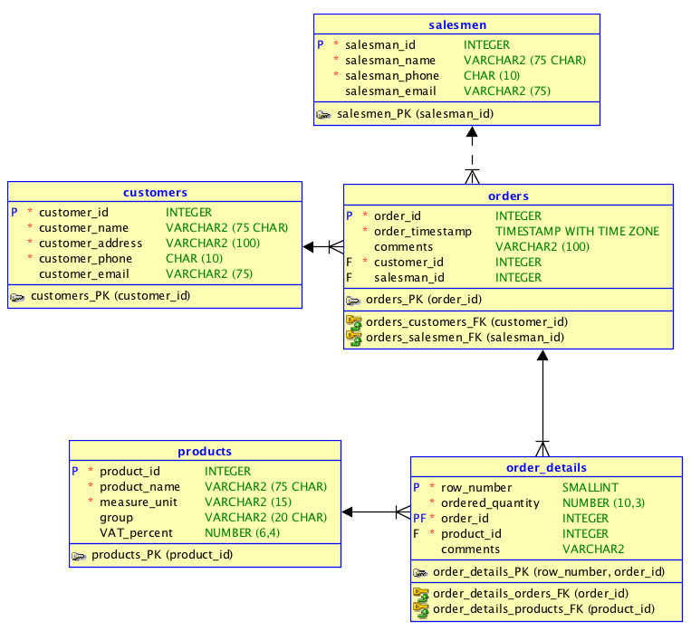
Generated Relational Schema for orders_1 Diagram

Slide 27
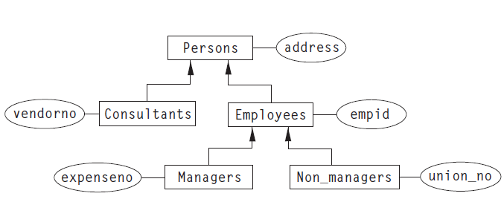
Hierarchy in E-R modeling
Source: Teorey, T. s.a. – Database Design. Know It All, MK, Amsterdam, 2009

Slide 28
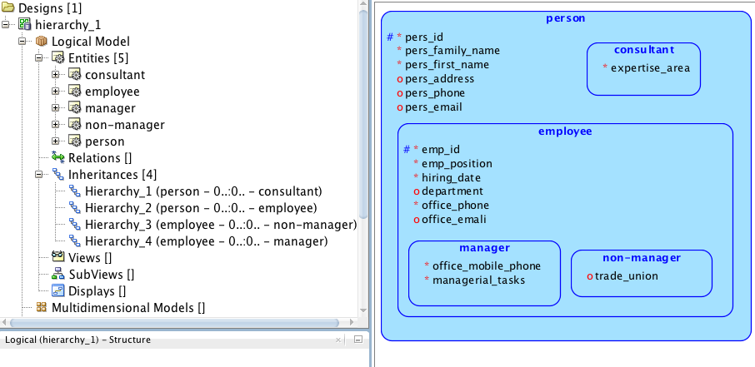
hierarchy_1 Diagram in ODM

Slide 29
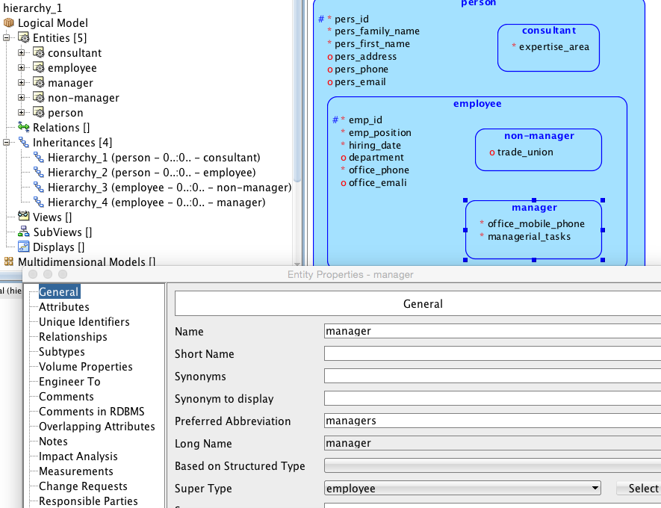
Declaring entities hierarchy in ODM

Slide 30
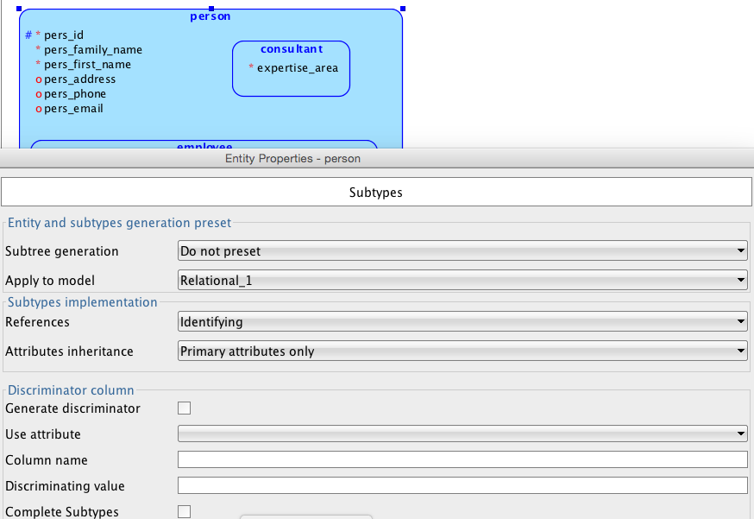
Declaring entities hierarchy in ODM (cont.)

Slide 31
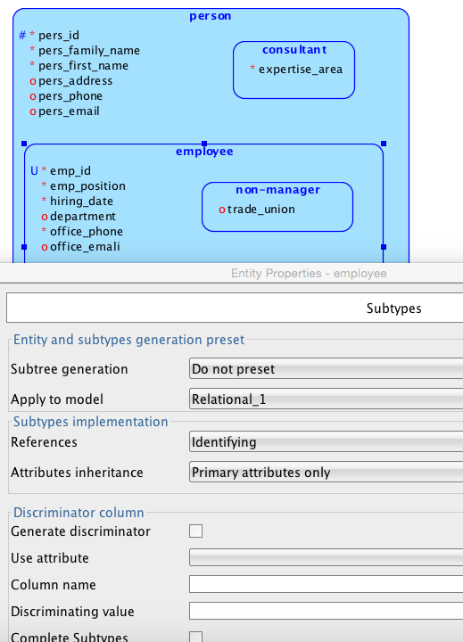
Declaring entities hierarchy in ODM (cont.)

Slide 32
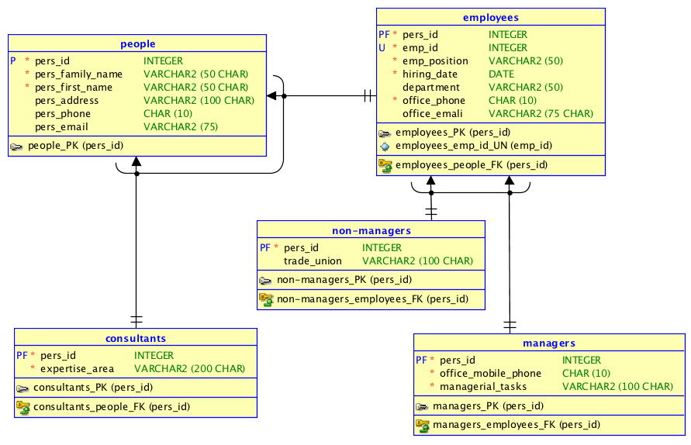
Generated Relational Schema for hierarchy_1 Diagram

Slide 33
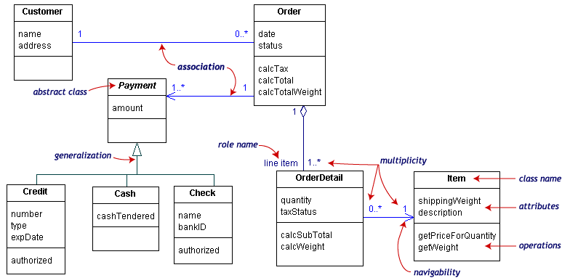
An UML Class Diagram

Slide 34
Useful Resources on Oracle Data Modeling
CIS1200 Database Systems - Using the Oracle SQL Developer Data Modeler tool & Project1 (2021)
https://www.youtube.com/watch?v=15gqoCB5LXs
Create Database design in Oracle SQL Developer Data Modeler (2020)
https://www.youtube.com/watch?v=eT5w6DTd2Dw
SQL Developer Data Modeler Just what you need (2018)
https://www.youtube.com/watch?v=NfrUy-TYP_8
Oracle SQL Developer Data Modeler
http://www.oracle.com/technetwork/developer-tools/datamodeler/overview/index.html
SQL Developer ER diagram sqlvids
https://www.youtube.com/watch?v=f80xWJYKJFQ&spfreload=10

Slide 35
Useful Resources on Oracle Data Modeling (cont.)
Re-engineering Your Database Using Oracle SQL Developer Data Modeler 4.0 (4.2)
http://www.oracle.com/webfolder/technetwork/tutorials/obe/db/sqldevdm/r40/mod1_dm_v4/mod1_dm_v4.html
Forward and Reverse Engineering Models and Working with Logical Model Diagrams, Displays and Subviews
https://apexapps.oracle.com/pls/apex/f?p=44785:24:0::NO:24:P24_CONTENT_ID,P24_PREV_PAGE:5231,29
Reverse Engineering your Oracle Database to a Relational Data Model
https://www.youtube.com/watch?v=hDwJN3KLXWY
Introduction to SQL Developer Data Modeler
https://www.youtube.com/watch?v=wsVh1zLmQb0
Using the Database Synchronization Feature
https://apexapps.oracle.com/pls/apex/f?p=44785:24:3125138319327:::24:P24_CONTENT_ID,P24_PROD_SECTION_GRP_ID,P24_PREV_PAGE:5951,,24#prettyPhoto
3 Oracle SQL Developer Data Modeler Features to Save Time and Make Fewer Mistakes
https://www.youtube.com/watch?v=s5oTpdLfRnU

Slide 36
Two Resources on UML Class Diagrams (not so important for our course)
Database design with UML and SQL, 3rd edition
http://www.tomjewett.com/dbdesign/dbdesign.php?page=intro.html
Data Modeling With the UML
https://www.youtube.com/watch?v=gaAYttaEbx0&spfreload=10

